Slide 1
TOSS New Director Training
August 2014
Notes:
WEBB
As an agency, we have always had a duty to the children of our state: to support their schools and their teachers in helping students – all students – achieve and prepare for their futures
Now, however, we have a special responsibility and privilege to Tennessee’s children, and working with our districts through the state we now have the resources to turn that responsibility into results
First to the Top is about making achievement – college and career readiness – a reality for students all across our state

Slide 2
Objectives
Review theory of accountability system
Review general rules for District Accountability
Review general rules for School Accountability
Review tools and resources

Slide 3
We have taken important and significant steps in education reform that are not recognized under AYP
Tennessee significantly raised standards through the Diploma Project, and passed broad education reform legislation.
As a result of the standards change, proficiency results dropped state-wide. 7th grade math dropped from 90.3% in previous year to 28.5%.
2009-10
Proficiency rates increased across the state, with high value-added growth scores.
But despite this very strong growth and improvement, 836 schools (or half the schools in the state) and 53 districts failed AYP.
2010-11
We see continued commitment to reforms and improvement. But unfortunately this growth and improvement is not recognized under AYP.
Without a waiver, we project that about 80% of schools and at least 40% districts would fail AYP based on this year’s results.
2011-12

Slide 4
ESEA Flexibility Waiver
ESEA Flexibility Waiver was granted to TN and waived designated portions of the ESEA as amended by No Child Left Behind 2001.
All other portions of ESEA remain in effect.
Major changes are the accountability system and Title I set-asides.

Slide 5
Our new accountability system has two over-riding objectives
Growth for all students, every year
and
Closing achievement gaps, by ensuring faster growth for those students who are furthest behind

Slide 6
Accountability Implications of LEA and School AMOs
AMO Category | LEA |  | School
 | Targets are used in accountability determinations⁽¹⁾ | Performance published in Report Card | Targets are used in accountability determinations | Performance published in Report Card
Achievement | √ | √ | x | √
Gap Closure | √ | √ | x | √
Subgroup | (2) | √ | x | √
Important Notes
(1) LEAs will only be evaluated on targets for which there are 30 or more students in the current year (2012-13) and the subsequent year (2013-14). However, this year’s AMOs include targets for all groups, regardless of size, for the purpose of guidance.
(2) LEAs are not evaluated on performance against exact subgroup targets for % Proficient or Advanced. Whether the subgroup showed improvement or decline in % Proficient or Advanced in a majority of measures for any subgroup contributes to accountability determinations.

Slide 7
Foundations for Accountability
Minimum N is 30 for determining if AMOs are met
Any SWD as defined by US ED is counted toward the N count of 30 (Functionally Delayed and Gifted aren’t part of the SWD subgroup)
Minimum N is 10 for reporting
Participation rate is 95%
To meet this requirement, the State will use the most current year, most current two years, or most current three years of participation rate data
Every Test Taker (ETT) – scores will be included for every student tested in the test cycle
Test Cycle – Prior Summer, Current Fall and Spring

Slide 8
Students with Disabilities and Accountability
Students with Disabilities
1% cap on the number of proficient and advanced scores based on the alternate achievement standards that can be included in calculations
Without approval of the waiver requesting the extension of the 1% cap, proficient scores exceeding this cap must be changed to below proficient for accountability purposes
2% cap on the number of proficient and advanced scores based on the modified achievement standards assessment that can be included in calculations
Proficient scores exceeding this cap must be changed to below proficient for accountability purposes

Slide 9
AMO Setting Method
For All Achievement and Subgroup Targets:
A district’s growth goal in % Proficient or Advanced (PA) for 2013-14 equals the annual percentage point gain necessary to reduce its % Basic or Below Basic (BBB) in 2012-13 by half over 8 years.
District A
3-8 Reading Achievement
District A tested 30% PA in 3-8 Reading;
%Basic or Below Basic= 100-%P/A=100-30=70
Growth Goal:
(70% × ½ = 35% ) ÷ 8 =
This rate of growth implies increasing the percentage PA by 35 percentage points over 8 years.
% PA
4.4%
2.5
District B
4.4
District B tested 60% PA;
%Basic or Below Basic=100-%P/A=100-60=40
Growth Goal:
(40% × ½ = 20% ) ÷ 8 =
This rate of growth implies increasing the percentage PA by 20 percentage points over 8 years.
District A
District B
2.5%
Current
Yr 1
Yr 2
Yr 3
Yr 4
Yr 5
Yr 6
Yr 7
Yr 8

Slide 10
AMO Setting Method
For All Gap Closure Targets:
A district’s gap reduction goal for 2013-14 equals the annual percentage point reduction necessary to cut its 2012-13 gap size in half over 8 years.
3-8 Math Economically Disadvantaged vs. Non-ED
District C
% PA
10.0
District C’s 3-8 Math gap between Economically Disadvantaged and Non-ED students is 20 percentage points in 2011-12. In order to reduce this gap at a rate that cuts the gap in half over 8 years, the reduction goal for 2012-13 needs to be 1.2%. The gap target is 18.8%.
Gap Reduction Goal:
(20% × ½ = 10% ) ÷ 8 = 1.2%
Gap Target:
20% - 1.3% =
18.7
20.0
1.3%
Gap Size
Economically Disadvantaged
18.7%
Non-ED
Yr 1
Yr 8

Slide 11
District Accountability review
Accountability 2014

Slide 12
Accountability Model- Two Parts
Achievement
How are All Students doing on tested subjects or measures?
Gap Closure
Are achievement gaps being closed in tested subjects and measures?

Slide 13
Districts Set the AMOs for SY 2013-14
Achievement | Gap Closure | Subgroup
For the following subject/grade levels, targets will be set for all students: | For the following subject/grade levels: | For the following subject/grade levels:
3-8 Reading 3-8 Math 3 Reading 3 Math 7 Reading 7 Math 9-12 Algebra I 9-12 Algebra II 9-12 English II 9-12 English III 9-12 Graduation Rate | 3-8 Reading 3-8 Math Algebra I + Algebra II* English II + English III* *Takes the average by weighting each subject by the number of students in each subgroup. | 3-8 Reading 3-8 Math Algebra I Algebra II English II English III 9-12 Graduation Rate
 | Gap targets will be set for these subgroup vs. comparison groups gaps: | Achievement targets will be set for these subgroups:
 | Black/Hispanic/Native American vs. All Students Economically Disadvantaged vs. Non-ED Limited English Proficient vs. Non-LEP Students with Disabilities vs. Non- SWD | Black/Hispanic/Native American Economically Disadvantaged Limited English Proficient Students with Disabilities
 |  | Asian Black Hawaiian Pacific Islander Hispanic Native American White
 |  | Non-ED Non-LEP Non-SWD

Slide 14
Accountability Model - Achievement
Steps
Determine if district met participation rate.
Determine numbers of AMOs met after all Safe Harbors are applied.
Determine for how many measures the district improved.
Determine status for achievement side of the model.
Achievement
How are All Students doing on tested subjects or measures?

Slide 15
Achievement Tests
Test | Question
Participation Rate Eligibility | Did the district/school have 30 or more students with valid tests in the current year for all students?
Participation Rate | Did the district/school have a 95 percent participation rate for the All subgroup?
Achievement AMO Target Eligibility Test | Did the district/school have 30 or more students with valid tests at the time the target was set and have 30 students or more in the current school year?
Achievement AMO Target Test | Did the district/school meet the AMO target without any safe harbors?
Improvement Test (Total) | Did the district/school improve in half or more of the eligible measures?
Improvement Test (Aggregate) | Did the district/school improve in 3-8 Math, 3-8 RLA, and half or more of the high school measures- Algebra I, Algebra II, English II, English III, and Graduation Rate?

Slide 16
Achievement Safe Harbors
Safe Harbor | Question
Confidence Interval Safe Harbor | Did the district/school make the AMO when the upper bound of the 95% confidence interval is applied?
TVAAS Safe Harbor | Did the district/school 1) receive an index value of 1 or higher (represented by dark green on TVAAS) for the current year if it is an elementary or middle school measure or 2) receive an index of 2 or higher (represented by dark green in TVAAS) in the current year if it is a high school measure?
Reduction in Percent Below Proficient Safe Harbor | Did the district/school reduce the number of students scoring basic/below basic by 10 percent over 1 year, or 19 percent over 2 years, or by 27 percent over 3 years?
Graduation Rate Safe Harbor | Did the district/school have a graduation rate that is greater than or equal to 95%?

Slide 17
Did the District Pass Participation Rate Test?
Did the District Pass a Majority of its AMOs after Safe Harbor?
Did the District Pass the Total and Aggregate Improvement Test?
Achievement Status
Pass
Improvement Test
ACHIEVE
Pass
Achievement AMO Target Test
Fail
Improvement Test
Achieve: Not Exemplary
Pass
Participation Rate Test
Pass
Improvement Test
MISS:
Intermediate Possible
Fail
Achievement AMO Target Test (Including Safe Harbors)
Fail
Improvement Test
MISS:
In Need of Improvement
Pass
Improvement Test
MISS:
In Need of Improvement
Pass
Achievement AMO Target Test
Fail
Improvement Test
MISS:
In Need of Improvement
Fail
Participation Rate Test
Pass
Improvement Test
MISS:
In Need of Improvement
Fail
Achievement AMO Target Test (Including Safe Harbors)
Fail
Improvement Test
MISS:
In Need of Improvement

Slide 18
Accountability Model- Gap Closure
Steps
Determine if district met participation rate.
Determine number of AMOs met after Safe Harbor is applied.
Determine for how many measures the district improved for each subgroup.
Determine status for gap closure side of the model.
Gap Closure
Are achievement gaps being closed in tested subjects and measures?

Slide 19
Gap Closure & Subgroup Tests
Test | Question
Gap Closure Eligibility Test | Did the district have at least 30 students in both the subgroup and the comparison group for the current year and the prior year?
AMO Gap Test | Did the district/school meet the Gap Closure AMO?
Subgroup Eligibility | Did the district/school have 30 valid test scores at the subject/subgroup level in the current year?
1 Year, 2 Year, & 3 Year Participation Rate | Did the district/school meet the participation rate for the subject/subgroup for current year, two year, or three years?
Subgroup Improvement Test | Did the district/school improve the percent of students scoring Proficient/Advanced in the subject/subgroup when compared to the prior year?

Slide 20
Gap Closure Safe Harbor
To meet the gap closure safe harbor the district MUST:
-Have at least 30 valid tests for the aggregate measure: 3-8 Math, 3-8 Reading, Algebra I/II, English II/III.
-The subgroup must hit its subgroup AMO for the measure.*
-The gap between the subgroup and comparison group MAY NOT widen.
District X Data 3-8 Math
 | 2013 | 2014 | AMO
ED | 30.2% P/A | 34.7% P/A | 34.6%
Non-ED | 45.4% P/A | 49.4% P/A | 48.8%
Gap | 15.2% | 14.7% | 14.3%
District:
-Hit ED AMO
-Missed Gap AMO
-Gap Didn’t Widen
Note: Subgroup AMOs were set in Algebra I and II separately and English II and III separately. To get the gap closure safe harbor, district must hit subgroup AMO in both subjects.

Slide 21
Did the District Pass the Subgroup Participation Test?
Did the District Pass the GAP AMO Target Test?
Did the District Pass the Subgroup Improve Test?
GAP Closure Status
Pass
Subgroup Improvement Test
ACHIEVE:
Gap Closure
Pass
Gap AMO Target Test
Fail
Subgroup Improvement Test
MISS:
In Need of Subgroup Improvement
Pass
Subgroup Participation Test
Pass
Subgroup Improvement Test
MISS:
Intermediate Possible
Fail
Gap AMO Target Test
Fail
Subgroup Improvement Test
MISS:
In Need of Subgroup Improvement
Pass
Subgroup Improvement Test
MISS:
In Need of Subgroup Improvement
Pass
Gap AMO Target Test
Fail
Subgroup Improvement Test
MISS:
In Need of Subgroup Improvement
Fail
Subgroup Participation Test
Pass
Subgroup Improvement Test
MISS:
In Need of Subgroup Improvement
Fail
Gap AMO Target Test
Fail
Subgroup Improvement Test
MISS:
In Need of Subgroup Improvement

Slide 22
Accountability Model - Making Final Determinations
Achievement
How are All Students doing on tested subjects or measures?
Gap Closure
Are achievement gaps being closed in tested subjects and measures?
Steps
Determine Achievement Status
Determine Gap Closure Status
Use Achievement Status and Gap Closure Status to determine Final Determination

Slide 23
District ACHIEVEMENT Measures – How are determinations made?
*Updated Summer 2013
Achievement Measures:
For 2011-12, ALL Students are measured in the following areas (up to 9 per LEA):
3rd grade Math
3rd grade RLA
7th grade Math
7th grade RLA
3-8 grades Math
3-8 grades RLA
HS: Algebra I
HS Algebra II
HS: English II
HS: English III
HS: Graduation Rate
AMOs are set to measure the required percent of annual growth in the % of students scoring proficient and advanced for All students.
AMOs are set so the number of students scoring below basic or basic is reduced in half over eight years.
Participation Rate Test: Is there a 95% Participation Rate in TCAP and EOC Assessments for ALL students?
MISS Achievement Measures
IN NEED OF IMPROVEMENT
No
Yes
Achievement AMO Test: Did the district meet the majority of eligible achievement AMOs after all safe harbors have been applied?
Yes
No
Achievement Improvement Test: Did the district improve in half of the eligible subjects?
Achievement Aggregate Improvement Test: Did the district improve in all aggregate measures (3-8 Math, 3-8 RLA, and at least half of the high school measures)?
Yes
No
Yes
No
ACHIEVE Achievement Measures
ACHIEVE: NOT EXEMPLARY
Achievement Measures
MISS Achievement Measures
INTERMEDIATE POSSIBLE
MISS Achievement Measures
IN NEED OF IMPROVEMENT

Slide 24
District GAP CLOSURE Measures – How are determinations made?
*Updated Summer 2013
Gap Closure Measures
Subgroups are measured in the following measures:
-3-8 Math
-3-8 Reading/Language Arts
-Algebra I + Algebra II
-English II + English III
Gap Closure AMOs are set for the following comparison groups:
-Black/Hispanic/Native American vs. All Students
-Economically Disadvantaged vs. Non-Economically Disadvantaged
-Students with Disabilities vs. Non-Students with Disabilities
-English Language Learners vs. Non-English Language Learners
Additionally, each of the 9 individual subgroups below must improve in half of the following measures:
-3-8 Math
-3-8 Reading/Language Arts
-Algebra I/Algebra II
-English II/III
Participation Rate Test: Is there a 95% Participation Rate in TCAP and EOC Assessments all individual subgroups with 30 or more students?
MISS Achievement Measures
IN NEED OF IMPROVEMENT
No
Yes
Gap Closure AMO Test: Did the district meet a majority of eligible AMOs outright or with the gap closure safe harbor applied?
Yes
No
Subgroup Improvement Test: Did the % of students scoring proficient or advanced increase in half of the measures?
Subgroup Improvement Test: Did the % of students scoring proficient or advanced increase in half of the measures for either Pathway 1 or Pathway 2?
Yes
No
Yes
No
ACHIEVE Gap Closure Measures
MISS In Need of Subgroup Improvement
MISS Intermediate Possible
MISS In Need of Subgroup Improvement

Slide 25
District ACHIEVEMENT and GAP CLOSURE Measures
What is the final outcome?
Final Achievement Status
Final Gap Closure Status
Final Determination
ACHIEVE: Gap Closure
Exemplary
ACHIEVE
MISS: In Need of Subgroup Improvement
In Need of Subgroup Improvement
MISS: Intermediate Possible
Intermediate
ACHIEVE: Gap Closure
Intermediate
ACHIEVE: Not Exemplary
MISS: In Need of Subgroup Improvement
In Need of Subgroup Improvement
MISS: Intermediate Possible
Intermediate
ACHIEVE: Gap Closure
In Need of Improvement
MISS: In Need of Improvement
MISS: In Need of Subgroup Improvement
In Need of Improvement
MISS: Intermediate Possible
In Need of Improvement
ACHIEVE: Gap Closure
Intermediate
MISS: Intermediate Possible
MISS: In Need of Subgroup Improvement
In Need of Subgroup Improvement
MISS: Intermediate Possible
In Need of Improvement

Slide 26
School Accountability
Accountability 2014

Slide 27
General Rules
Determinations made in specific order
1) Priority
2) Focus
3) Reward
Schools can have only ONE determination in a given year
All schools with at least one year of data will be included in success rate calculations
Schools must have at least two and up to three years of data to receive a determination

Slide 28
Schools are placed into pools – 3-8 Pool or 3-12 Pool
3-8 Pool
Includes all schools with at least 30 valid tests in a single 3-8 subject but not 30 valid tests the 9-12 grade spans.
3-12 Pool
Includes all schools with at least 30 valid tests in a single 9-12 subject, including schools that cross both grade spans (i.e K-12, 6-9)

Slide 29
Pool Assignment Example
Valid tests by subject in the 2013-14 SY | School A | School B | School C | School D | School E
3-8 Math | 250 | 0 | 145 | 100 | 25
3-8 Reading | 255 | 0 | 150 | 95 | 20
Algebra I | 0 | 150 | 25 | 35 | 0
English II | 0 | 150 | 0 | 35 | 0
English III | 0 | 125 | 0 | 25 | 0
Pool Assignment | 3-8 Pool | 3-12 Pool | 3-8 Pool | 3-12 Pool | No Pool Assignment
Reasoning | No valid tests in any of the EOCs or grades 9-12 subjects | No valid tests in any of the 3-8 grades and subjects | Has valid tests in Algebra I, but valid tests are <30 and all other valid tests in grades 3-8 | Has at least 30 valid records in Algebra I and English II as well as records in 3-8 subjects | Does not have enough valid tests in any subjects
Note: Subjects where number of valid tests is less than 30 are not included. These are highlighted in red.
Note: When students in grades less than 9 take an EOC, those scores are converted to their 3-8 subject prior to pool assignment.

Slide 30
Exclusions
 | Is it in the overall pool of schools? | Does it receive a determination?
Schools with only graduation data | YES | NO
Schools with only 1 year of data | YES | NO
Schools that closed as of July 1st of the current school year | YES | NO
CTE & Adult High Schools Department of Children’s Services Tennessee School for the Deaf West Tennessee School for the Deaf Tennessee School for the Blind Alternative Schools* | NO | NO
*Student scores at alternative schools are remanded to their home districts and schools

Slide 31
Calculate Success Rates
Success Rate: shows the percent of students proficient/advanced across all subjects.
3-8 Pool Success Rate
3-12 Pool Success Rate
#P/A in Math, Reading/LA,
Science
÷
# Valid Tests in Math, Reading/LA
Science
#P/A in Math, Reading/LA
Science, Algebra I, Algebra II, English I, English II, English III, Biology I, # of Graduates
# Valid Tests in Math, Reading/LA
Science, Algebra I, Algebra II, English I, English II, English III, Biology I, # in Graduation Cohort
÷
Note: Graduation data lags one year; graduation rate uses the graduating classes of 2012-13, 2011-12, and 2010-11. In addition, Algebra II and English III have been included in success rate calculations.

Slide 32
What data goes in the Success Rate?
Does the subject have 30 valid tests?
Are there at least two years of data?
Example: School A – Valid Test Counts
 | Algebra I | Algebra II
2014 | 35 | 25
2013 | 28 | 20
2012 | 30 | 30
Note: The counts that are shaded in green are included in success rate; the counts that are shaded red are not included.

Slide 33
Priority Schools Overview

Slide 34
Priority Schools
5 percent of the lowest performing schools in the state as defined by the three year Success Rate for the “All Students” group
Number of schools selected
5 percent of all schools

Slide 35
Priority School Methodology
Place schools in one of two pools:
3-8 or 3-12
(Slide 5)
Calculate Success Rate for All Students group
(Slide 8)
For each pool, order Success Rates from greatest to smallest
Apply school exclusion rules
(Slide 7)
Identify lowest success rates that allow the selection of 5% of all schools in state

Slide 36
Focus Schools Overview

Slide 37
Changes to Focus School Method
Change | Before: 2012 | Now: 2014
Success Rate Formula | Used composite “proficient, advanced, or graduated” performance on Algebra and English assessments and graduation rates in high school | Uses the same subjects in the Priority/Reward Success Rates. Added: Algebra II English I English III Biology I
Gaps | Used to combine gaps for subgroups and their comparison groups using a weighted gap methodology | Gaps are calculated by taking the difference in success rates between the historically underperforming subgroup and its comparison groups, and each gap is ranked separately
Subgroup and Comparison Groups | Ten percent of schools with highest weighted gap index were selected | Equal proportion of gaps for subgroups are selected
Low Subgroup Success Rates | Schools having any subgroup with Success Rates below five percent were automatically identified as Focus | Per state ESEA Flexibility Waiver, schools having any subgroup with success rates below ten percent are automatically identified as Focus

Slide 38
Focus Schools
Must include:
Ten percent of all schools, which includes ten percent of Title I schools
Identified through one of three pathways:
10% of Schools
Pathway 1: High schools with up-to three year grad rate <60%
Pathway 3: Schools with largest within-school gaps between comparison groups
Pathway 2: Any subgroup with Success Rate below 10%

Slide 39
Subgroups
Pathway 2 Subgroups
Pathway 3 Gap Subgroups & Comparison Groups
ALL
African-American/Black
Asian
Hawaiian/Pacific Islander
Hispanic
Native American
White
Economically Disadvantaged
Students with Disabilities (SWD)
Limited English Proficiency (LEP)
ALL students vs. BHN
Non-ED vs. ED
Non-SWD vs. SWD
Non-LEP vs. LEP
Note: Schools identified for subgroup success rates less than 10%
Note: Schools identified for having largest gaps in these groups.

Slide 40
Subgroup Eligibility
Eligible subgroups have at least 30 valid tests in the subject AND that same subgroup has at least two years of data
Tests records in red are not included in the success rate calculation
Example: Students with Disabilities Count of Valid Tests
 | 3-8 Math | 3-8 Reading | 3-8 Science
2014 | 35 | 20 | 31
2013 | 28 | 25 | 25
2012 | 29 | 30 | 20

Slide 41
Focus School Methodology
Place schools in one of two pools:
3-8 or 3-12
(Slide 5)
Calculate Success Rate
(Slide 8)
Exclude schools that meet Focus safe harbors
(Slide 19)
Apply school exclusion and exemption rules
(Slide 7)
Identify schools based on Graduation Rate Pathway
Calculate gaps for Gap Pathway
Identify schools based on Subgroup Pathway
Title I schools: Sort gaps from greatest to least in the 4 subgroups and comparison groups for each pool
Identify 10% of Title I schools so that equal proportion of schools are selected from each subgroup/comparison group
All remaining schools: Sort gaps from greatest to least in the 4 subgroups and comparison groups for each pool
Identify remaining number of schools so that equal proportion are selected from each subgroup/comparison group so that 10% of all schools are selected

Slide 42
Focus Safe Harbors
Exemptions: Meeting at least one of the three “safe harbors” below can exempt a school from Focus identification in the Gap Pathway. Exempt schools cannot be identified as Focus. All of the Focus safe harbors use one year Success Rates.
Gap Pathway Safe Harbors
Performance | Growth | Gap
One year Success Rate of every eligible subgroup in a school is at or above the one year State Success Rate for ALL Students | School’s Success Rate for a particular subgroup has increased more between the current year and the previous year than the State Success Rate for the corresponding subgroup. *School cannot be selected for this subgroup. | All eligible subgroups have reduced their one year gap by 6.25% or more from the previous year to the current year
*Exemption means the school cannot be identified as a Focus School.

Slide 43
Steps in the Gap Pathway Determination
Round 1: Title I Schools Only
a) Start with Title I schools only
b) For each subgroup (ED, BHN, SWD, ELL), rank Title I schools by size of the gap
c) Flag 10% of Title I schools with the highest gaps for each subgroup making sure that an equal percentage of schools are selected from each subgroup
(note: Schools will be on each list for each subgroup where eligible.)
Round 2: Unselected Title I Schools from Round 1 and Non-Title I Schools
d) Add non-Title I Schools with the unselected Title I Schools from step c.
e) For each subgroup, rank non-Title I schools and unselected Title I schools by the size of the gap
f) Flag until 10% of all Schools have been selected with the highest gaps for each subgroup making sure that an equal percentage of schools are selected from each subgroup

Slide 44
Things to Remember: Certain subgroups have more eligible schools than others.
Economically Disadvantaged | Students with Disabilities | Black/Hispanic/Native American | English Language Learners
School A School B School C School D School E School F School G School H School I School J | School A School B School K School L School M School N School O School P | School A School B School C School Q School R School S School T | School R School U School V School W

Slide 45
Things to Remember: Schools can be eligible for identification for multiple subgroups
Economically Disadvantaged | Students with Disabilities | Black/Hispanic/Native American | English Language Learners
School A School B School C School D School E School F School G School H School I School J | School A School B School K School L School M School N School O School P | School A School B School C School Q School R School S School T | School R School U School V School W

Slide 46
Things to Remember: Schools will be selected from all subgroups for Focus. Equal percentage of subgroups will be selected but not an equal number of schools
Economically Disadvantaged | Students with Disabilities | Black/Hispanic/Native American | English Language Learners
School A School B School C School D School E School F School G School H School I School J | School A School B School K School L School M School N School O School P | School A School B School C School Q School R School S School T | School R School U School V School W

Slide 47
Things to Remember: Schools can be identified for Focus for more than 1 subgroup, but the school will only be counted once in the identification process
Economically Disadvantaged | Students with Disabilities | Black/Hispanic/Native American | English Language Learners
School A School B School C School D School E School F School G School H School I School J | School A School B School K School L School M School N School O School P | School A School B School C School Q School R School S School T | School R School U School V School W

Slide 48
Reward Schools Overview

Slide 49
Reward Schools
10% of Schools
5 % Performance (Measured by 1 Year Success Rate)
5 % Progress (Measured by 1 Year TVAAS Composite)
Schools ranking in the top 5% of all one-year Success Rates for the “All Students” group
Top 5% of schools with the highest TVAAS school composite scores

Slide 50
Reward Performance Methodology
Place schools in one of two pools- 3-8 or 3-12
(Slide 5)
Apply school exclusion and exemption rules
(Slide 7)
Calculate Success Rates for both 3-8 and 3-12 pool
(Slide 8)
Identify the # of schools to be identified; should make up 5% of all schools
Identify the # of schools that equal the top 5% of schools with highest Success Rates

Slide 51
Reward Progress Methodology
Place schools in one of two pools- 3-8 or 3-12
(Slide 5)
Apply school exclusion and exemption rules
(Slide 7)
Sort remaining schools by 1-year composite TVAAS growth score from greatest to least
Identify the # of schools to be identified; should make up 5% of all schools
Identify the # of schools that equal the top 5% of schools with highest 1-year composite TVAAS scores

Slide 52
Reward Exemptions
Reward Exemptions: Schools are exempt from Reward status for having significant gaps. When a school is exempt from Reward status, they may not receive the status even if their success rate and/or one-year TVAAS school composite falls within the range to identify the school as Reward.
To be exempt from Reward School, the school must meet BOTH the following criteria for the SAME subgroup
State Gap Exemption | AND | Widen Exemption
Schools have one year Success Rate gap that is bigger than State Success Rate gap for any of the eligible subgroups* |  | The gap has widened for that same eligible subgroup from previous year to current year
*eligible subgroups: BHN, ED, ELL, and SWD
Notes:
I want to take this out…. This is a general exemption for all designations

Slide 53
How Do Exemptions Work?
Exemption Example
Subgroup | State Gap Exemption | Widen Exemption | Can the school be identified as Reward?
School # 1
Black/Hispanic/Native American | Yes | Yes | No
Economically Disadvantaged | No | No
English Language Learners | No | No
Students with Disabilities | Yes | No
School # 2
Black/Hispanic/Native American | Yes | No | Yes
Economically Disadvantaged | No | Yes
English Language Learners | No | Yes
Students with Disabilities | Yes | No

Slide 54
Data release
Accountability 2014

Slide 55
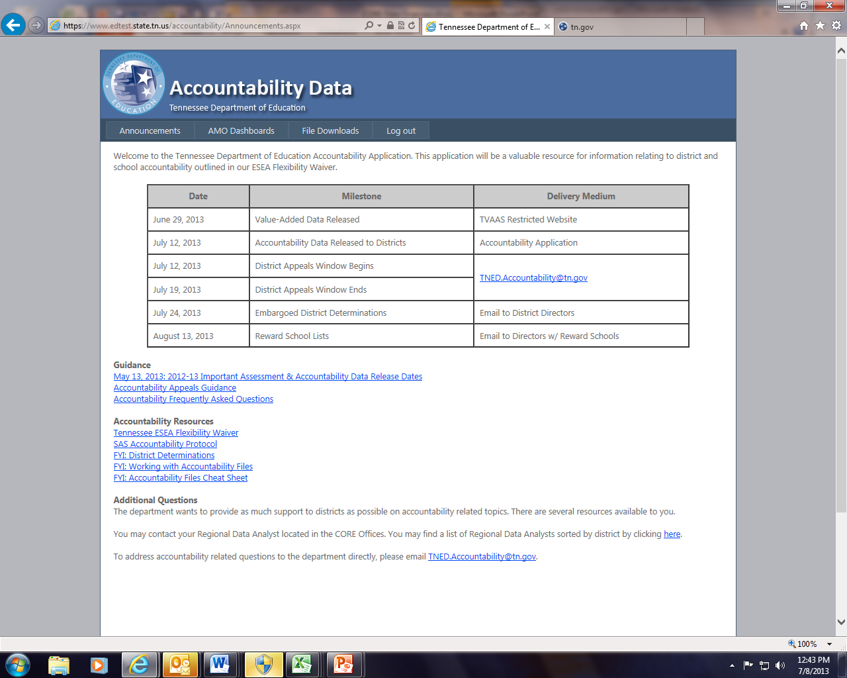
Accountability Application- Announcements Tab

Slide 56
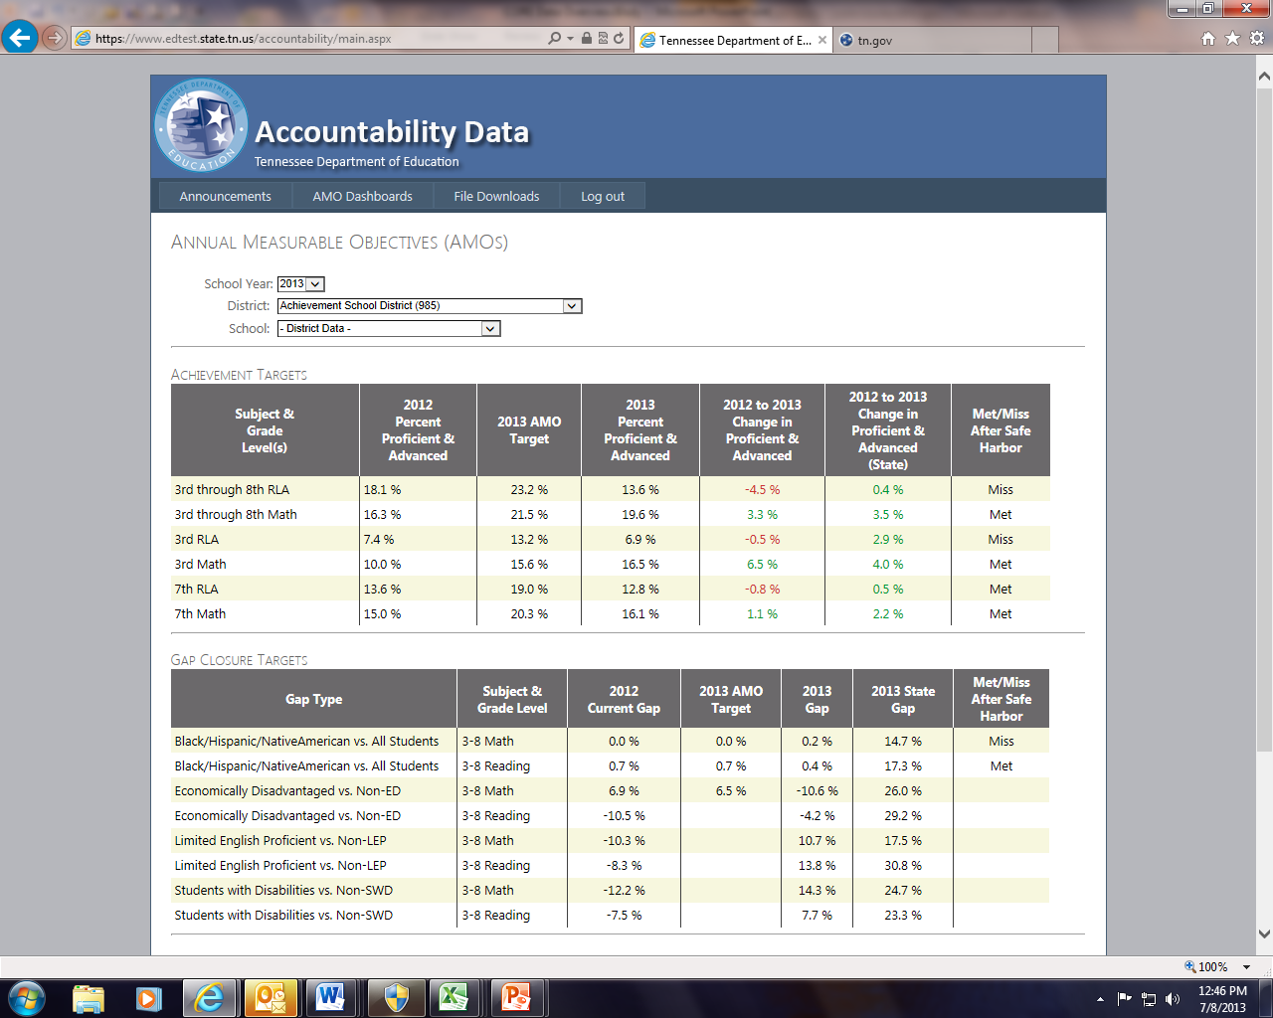
Accountability Application- AMO Dashboard

Slide 57
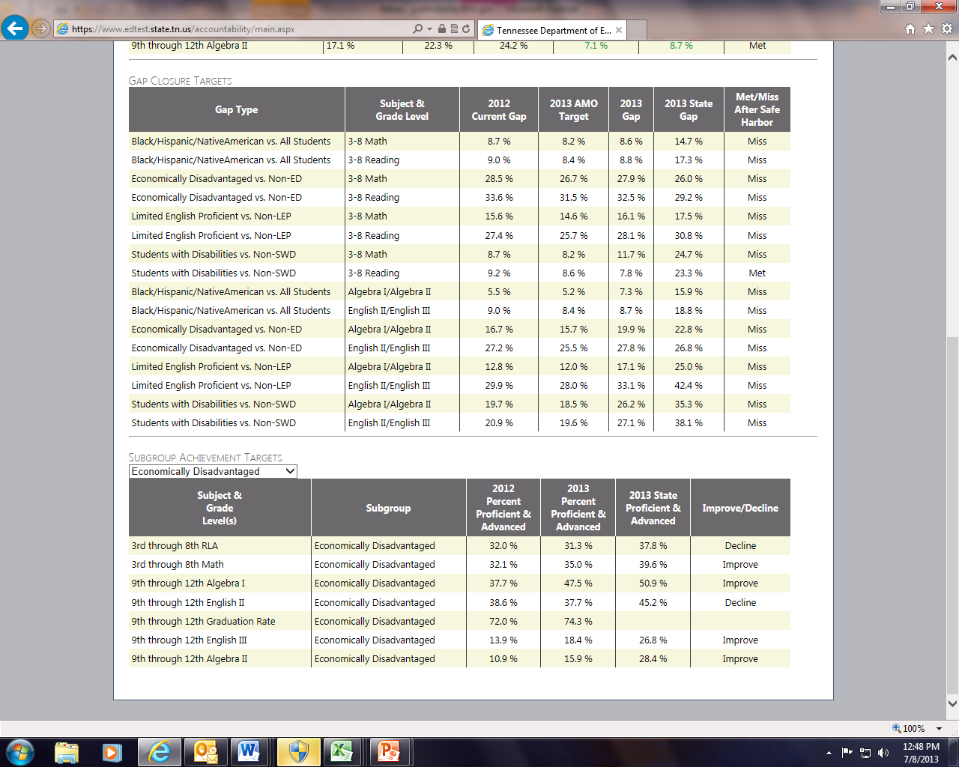
Accountability Application- AMO Dashboard

Slide 58
What May Districts Appeal?
What may be appealed?
What may not be appealed?
Large, systematic errors
The error impacts a large portion of the district’s tested population
The error occurred due to a data migration that could not have been rectified during SDDV
Accountability Methodology Errors
AP English/English III
Only for districts where English III would help final status
Individual corrections of student demographic data
Philosophical Appeals
No changes to the methodology

Slide 59
Additional Support
Regional Data Analysts
Based in CORE Offices
Provide support on accessing and interpreting accountability data
Answers general accountability/data questions
Several have consortium meetings where regional administrators talk about best practices
Find Yours at the following link:
TNED.Accountabilty
Direct access to TDOE Accountability Support Team via email
Will answer questions on accessing and interpreting data, accountability methodology, etc.
Password Resets
Every School Director should have a DATA account to access the accountability application.
To request a reset, the Director must email TNED.Accountability

Slide 60
Questions and Discussion
Email additional questions to tned.assessment@tn.gov
Notes:
WEBB
As an agency, we have always had a duty to the children of our state: to support their schools and their teachers in helping students – all students – achieve and prepare for their futures
Now, however, we have a special responsibility and privilege to Tennessee’s children, and working with our districts through the state we now have the resources to turn that responsibility into results
First to the Top is about making achievement – college and career readiness – a reality for students all across our state

Slide 61
Accountability Changes
Accountability 2014

Slide 62
New! Subgroup Improvement Test
Issue: Unintended consequences from combining Algebra I/II and English II/III.
Difficulty for districts to determine which subject needs improvement or driving them to In Need of Subgroup Improvement
Resolution: District may pass the subgroup improvement test by either Pathway 1 or Pathway 2.

Slide 63
Subgroup Improvement Test Pathways
Pathway 1
Pathway 2
District may demonstrate satisfactory progress by improving in at least half of the following grades and subjects:
3-8 Math
3-8 Reading,
Algebra I
Algebra II
English II
English III English III.
Districts may demonstrate satisfactory progress by improving in at least half of the following grades and subjects:
3-8 math
3-8 reading
Algebra I/II*
English II/III*
*Both Algebra I and II must improve for Algebra I/II to improve. Same for English II/III.

Slide 64
Subgroup Improvement Test
3-8 Math | 3-8 Reading | Algebra I | Algebra II | English II | English III
Improve | Decline | Improve | Decline | Decline | Improve
Pathway 1: Pass
District improved in at least half of the subjects
Pathway 2: Fail
District improved in 1 of the 4 subject grade combinations
Algebra I/II Decline; English II/III Decline

