Slide 2
Response to Intervention is NOT:
Just a Special Education initiative
Only for students with disabilities
Only for beginning reading
A new way to identify students with SLD
A way of reducing costs or eliminating special education or the LD category
This year’s summer reform or a short-term implementation based on “RTI in a Box”
A way to fix schools with weak core instruction
Source: Fletcher, Jack (2013) Classifications and Definitions for the Identification of Learning Disabilities: An Evaluation of the Research. Presentation for RTI²: A School Psychologist’s Guide to Implementation. Murfreesboro, TN.

Slide 3
Response to Intervention Is:
A set of processes for coordinating high quality service delivery in schools
A multi-tiered, layered instructional approach that prevents problems first, and then brings increasingly intense interventions to students who don’t respond
Making instructional decisions based on data
Integrating entitlement programs with general education
Providing relevant data for SLD identification
Primary goal: Improving academic (and behavioral) outcomes for all students by eliminating discrepancies between actual and expected performance.
Source: Fletcher, Jack (2013) Classifications and Definitions for the Identification of Learning Disabilities: An Evaluation of the Research. Presentation for RTI²: A School Psychologist’s Guide to Implementation. Murfreesboro, TN.

Slide 4
Required Elements:
Universal Screening: The Universal Screening tool will be skills-based and provide national norms. It will be administered 3 times a year for grades K-8 and is recommended for grades 9-12 (see Component 1.3 of the Implementation Guide).
Tier I: Core instruction will be provided to ALL students using grade-level Common Core State Standards in ELA and Mathematics.
Tier II and Tier III: Tiered interventions will be provided in addition to the core instruction provided at Tier I. Interventions will be research-based and will address a student’s area of deficit. They will be provided within the time frames described in Components 3.2 and 4.2 of the RTI² Manual.
Progress Monitoring: Progress monitoring will occur in the specific area of deficit at the frequency described in Components 3.3 and 4.3 of the RTI² Manual.

Slide 5
Required Elements:
District and School RTI² Teams: District and School RTI² Teams will be established per the guidelines outlined in Component 1.2. School teams will meet every 4.5 weeks at a minimum to make data-based decisions that inform instruction/intervention.
Fidelity of Implementation: Fidelity monitoring will occur as described in Components 2.6, 3.6 and 4.6 of the RTI² Manual and Implementation Guide.
Parent Contact/Communication: Parents will be notified of student progress as described in Component 1.6 of the RTI² Manual and Implementation Guide.
Highly trained personnel: Highly trained personnel will provide interventions. Highly-trained personnel are those who are adequately trained to deliver the selected intervention as intended with fidelity.

Slide 6
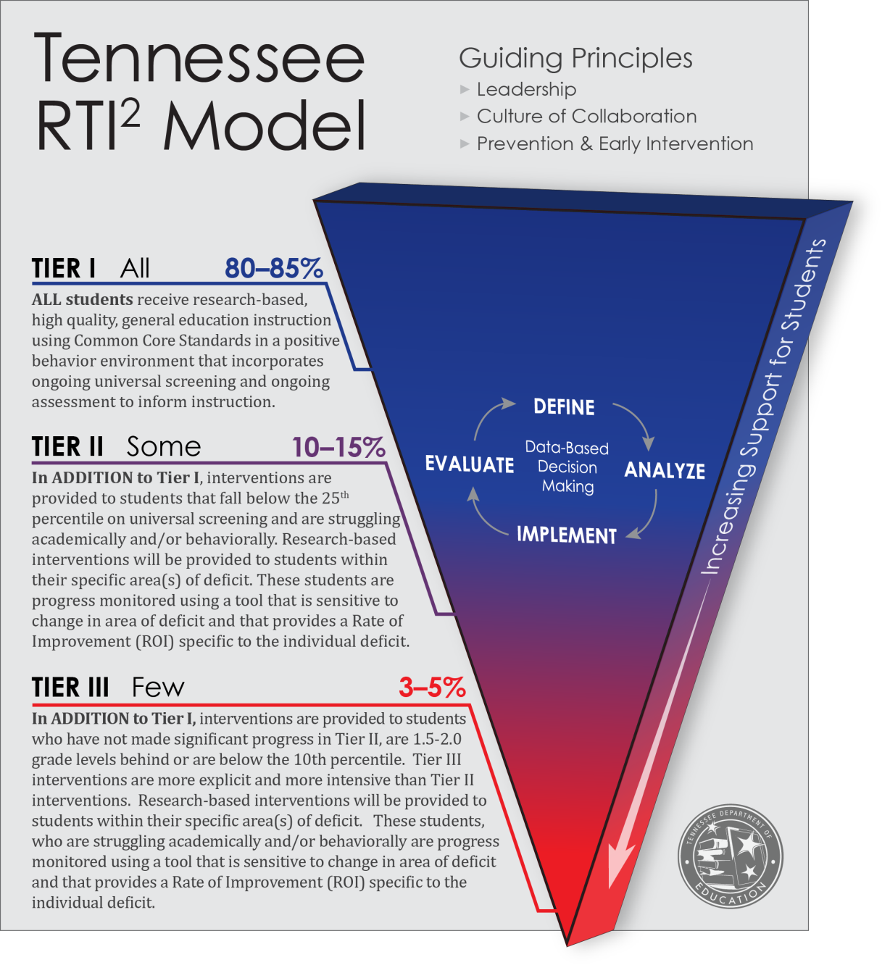

Slide 7
Map backwards: Skill specific universal screeners will measure:
Basic Reading Skills (letters, letter sounds, phonological awareness decode)
Reading Comprehension
Reading fluency
Written expression
Math calculation
Math reasoning (problem solving)

Slide 8
What does your Universal Screener tell you?
Standards based
Skills based
Intervene on a standard
Tells you what to reteach/remediate (Tier 1)
Adaptive, changes over time
Does not consistently measure the same skill over and over to determine if intervention is working
Intervene on skill deficit/need
Warning system for your most at-risk students and identifies discrete skill deficit(s)
Not adaptive
Consistently measures same skill
Independent of curriculum and standard

Slide 9
At All Tiers
District and school teams
Universal Screener
Assessments (ongoing and progress monitoring)
Recommended Instructional Time
Fidelity Monitoring
Parent involvement
Professional Development

Slide 11
Tier I - Instruction
Classroom instruction for all - Common Core State Standards
Research shows 80-85% of students will respond to Tier I
Recommended Instructional Time
ELA: K-2/150 min; 3-5/90 min; 6-12/55 traditional 90 block
Math: K-1/60 min; 2/75min; 3-5/90 min; 6-12/55 traditional 90 block
Ongoing Assessments (grade level checks, benchmarks)
Collect data points, determine patterns, track individuals and groups,
Guide instruction (teach/assess/monitor/adjust)
Fidelity Monitoring (Team, Student Data, etc…)
Universal Screener (K-8, recommended 9-12)(students below 25% go to Tier II)

Slide 12
Reteaching/Remediation VS. Intervention
Reteaching/Remediation
Intervention
Tier I-Common Core Standards
Goal is to reteach standards that students are struggling with rather than specific skill deficits. These are your “bubble kids”.
Standards Based Assessment:
Benchmark Assessment
Summative Assessment
Formative Assessment
Tier II/III/Special Education Intervention
Goal is provide research based interventions aligned to specific skill deficit(s) as identified by a universal screener.
Skills Based Assessment:
Skills based universal screener aligned to area(s) of deficit
Skills based Progress Monitoring specific to area(s) of deficit
Formative assessment

Slide 14
Tier II - Intervention
High quality research based intervention in specific area of deficit (standards protocol or problem solving or hybrid of 2)
Research shows 10-15% will need Tier II
30 minutes of explicit instruction daily, small groups
Universal Screener (K-8, recommended 9-12)(Based on national norms)
Survey-Level assessment (process to determine the basic skill area of deficit)

Slide 15
Tier II - Intervention
Progress Monitor (every 1-2 weeks in area of deficit)
Collect data points, determine patterns, track individuals
Fidelity Monitoring (3 times a marking period, at least 2 direct observation)
Rate of Improvement
Taught by highly trained personnel

Slide 17
Tier III - Intervention
High quality research based intervention in specific area of deficit (the most intensive intervention possible)
Research shows 3-5% will need Tier III
45-60 minutes of explicit instruction daily, small groups
Universal Screener (K-8, recommended 9-12)(Based on national norms)
Survey-Level assessment (process to determine the basic skill area of deficit)

Slide 18
Tier III - Intervention
Progress Monitor (every 1-2 weeks in area of deficit)
Collect data points, determine patterns, track individuals
Fidelity Monitoring
5 times a marking period
3 direct observation (at least)
2 must be a review of implementation data (student attendance, lesson plans, progress monitoring results
Rate of Improvement
Taught by highly trained personnel

Slide 19
Specific Learning Disability Definition:

Slide 20
Tier II, Tier III or Sp.ed Intervention : Core Instruction Plus A skill specific intervention
Core Instruction
Tier II
Tier III
Sp.Ed Intervention

Slide 21
Core instruction plus Intervention (Tier II, Tier III or Sp.Ed)
Core Instruction Plus Tier II (30 minutes daily)
Core Instruction Plus Tier III (45-60 minutes daily)
Core Instruction Plus Sp.Ed Intervention (More Intensive than Tier III)

Slide 22
Special Education Intervention for a student with a Specific Learning Disability: Is…. Is Not:
In addition to core instruction provided by general ed. teacher
The most intense intervention
Specific to the area of deficit/need
Research based
Provided by trained professional
Monitored to measure student progress
Based on data to determine appropriate interventions and services
a place to put students that struggle
One size fits all
Not based on a standard
Tutoring
The only intervention available

Slide 23
Response to Instruction & Intervention Implementation Guide
More details on each Tier
Scheduling samples
Rubric for universal screeners and interventions
Scenarios
Parent letters and communication samples
Students entering mid-term
ELL guidance

Slide 24
Implementation Readiness

Slide 25
Step 1: Universal Screening Begin by looking at your universal screener and your universal screening data.
End

Slide 26
Step 2: Master Schedules
End

Slide 27
Step 3: School and District RTI² Teams
End

Slide 28
Step 4: Interventions Next, look at your interventions for reading, mathematics and writing
End

Slide 29
Members of the Reading & RTI Leadership Council:
Cindy Ables, ELA Coordinator, Lincoln County Schools
Susan Dold, Elementary ELA Supervisor, Memphis City Schools
Nancy Duggin, Consultant
Marianne Gilbert, K-5 Literacy Supervisor, Williamson County Schools
Stacy King, Common Core Specialist, Greeneville City Schools
Sherry Roberson, Special Education Supervisor, Putnam County Schools
Janet Sexton, Elementary Reading Supervisor, Knox County Schools
Sherry Shroyer, Principal, Bradley County Schools

